Slide 1

Fake Videos
Did you know:
Project Real was created by young people, teachers, university academics and influencers

Slide 2
Aims
Understand why people might make fake videos
Explore how you can check if videos are real
Think about positive and negative use of fake videos

Slide 3
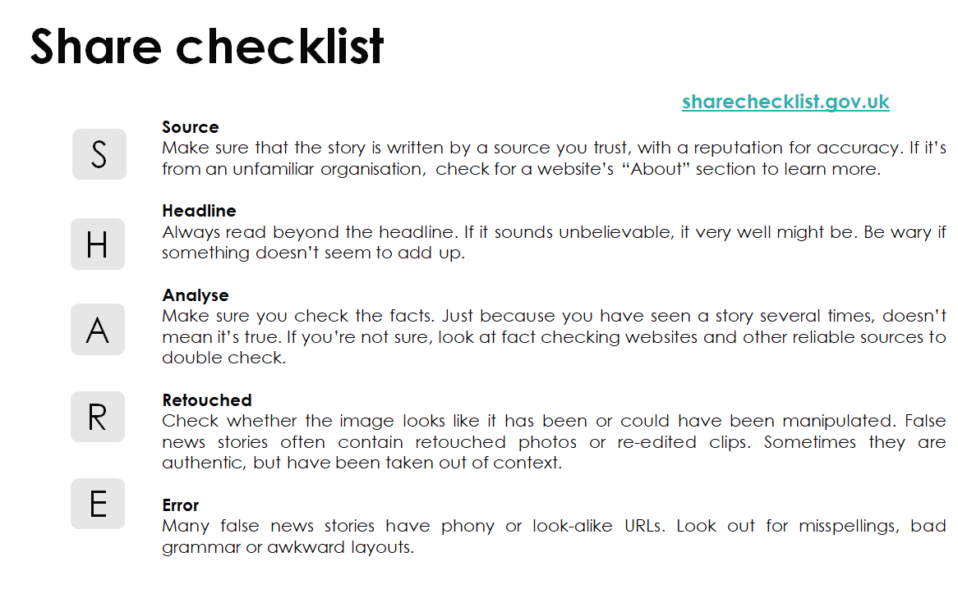

Slide 4
Starter - Discussion
Have you seen any fake videos online? What were they?
How did you know they were fake?

Slide 5
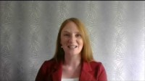
Fake Videos with Dr Yvonne Skipper
Notes:
https://youtu.be/anJGi3wiKXs

Slide 6

Main Activity
You will now see some videos and it is your job to work out if they are real or fake
Think about why you believe they are real or fake and use the SHARE guidelines to help you decide
Notes:
We suggest getting students into small groups. Play the video and ask them to discuss whether the video is real or fake and to give reasons why they believe this. The answers are shown on a separate slide after the discussion questions.

Slide 7
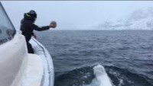
Notes:
https://www.youtube.com/watch?v=7uMSl28_8Rw

Slide 8
Questions
Is this a real or a fake video?
How do you know?
What did you look for to know if it was real or fake? (SHARE guidelines)

Slide 9
This video is…
Real
The whale did play with the ball
While it seems unrealistic, internet research using reliable sources reveals that this did happen
The video looks realistic!

Slide 10
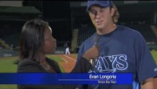
Notes:
https://www.youtube.com/watch?v=tMujgAAyH-I

Slide 11
Questions
Is this a real or a fake video?
How do you know?
What did you look for to know if it was real or fake? (SHARE guidelines)

Slide 12
This video is…
Fake
Internet research reveals it is fake
It is not realistic that a person would know the ball was coming!
There is a bit of ‘juddering’ when the video is edited but we might put this down to the cameraperson worrying about being hit
The stands are empty during this ‘interview’

Slide 13
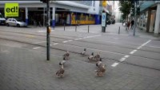
Notes:
https://www.youtube.com/watch?v=OrtkqXzPG-c

Slide 14
Questions
Is this a real or a fake video?
How do you know?
What did you look for to know if it was real or fake? (SHARE guidelines)

Slide 15
This video is…
Fake
Internet research reveals it is part of a German road safety campaign (Source)
The ducks’ feet do not look realistic (Error)
It is unlikely ducks could use a crossing! (Analyse)

Slide 16
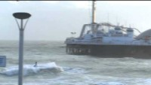
Notes:
https://www.youtube.com/watch?v=PEZiZ9G-gNs

Slide 17
Questions
Is this a real or a fake video?
How do you know?
What did you look for to know if it was real or fake? (SHARE guidelines)

Slide 18
This video is…
Real
Internet research reveals that the kite surfer had been working to do this for a long time
You can find other videos from different angles

Slide 19
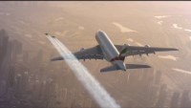
Notes:
https://www.youtube.com/watch?v=_VPvKl6ezyc

Slide 20
Questions
Is this a real or a fake video?
How do you know?
What did you look for to know if it was real or fake? (SHARE guidelines)

Slide 21
This video is…
Real
Internet research reveals that Emirates sponsored the development of the jet suit
The video shows lots of angles and the lighting and weather seem correct

Slide 22
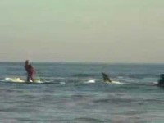
Notes:
https://www.youtube.com/watch?v=6zc79UQj1hQ

Slide 23
Questions
Is this a real or a fake video?
How do you know?
What did you look for to know if it was real or fake? (SHARE guidelines)

Slide 24
This video is…
Fake
It is unlikely this would happen (Analyse)
The shark would have to be huge to do this and the fin sometimes does not seem realistic (Retouch)

Slide 25
Closing Activity
Quick Fire Quiz
Notes:
Ask students to get into groups and nominate someone to answer. The first person to put their hand up and get the right answer wins a point for their team.

Slide 26

Name a popular fake video

Slide 27
Name a popular fake video
Tom Cruise
Queen’s speech at Christmas
...many others!

Slide 28
Give three ways to spot a fake video

Slide 29
Give three ways to spot a fake video
Source- who released the video? Was it from a spoof or trustworthy website? Was it released by the person in it?
Headline- is it really believable/realistic e.g., would the Queen release a video like that?
Analyse- does the context of the video add up to real life e.g., was Tom Cruise in America when this was filmed?
Retouched- does the video look real (note: they are getting better and better so it is important not to always rely on this) e.g., do the head movements match the rest of the body?
Error- are there any mistakes in the video? E.g., in the movements, accent, etc.?
...others?

Slide 30
Give one positive of fake videos
Notes:
Humour, entertainment, financial reasons e.g. don't actually have to pay Tom Cruise to come to a studio

Slide 31
Give one positive of fake videos
Humour
Entertainment
Financial reasons e.g. don't actually have to pay Tom Cruise to come to a studio
Education, e.g., learn from about paintings from Picasso himself
Training videos are more interesting than manuals
Dubbing films from another language
… others?

Slide 32
Give one negative of fake videos
Notes:
Can be done without people's permission, can be used in a harmful way

Slide 33
Give one negative of fake videos
Can be done without people's permission,
Can be used in a harmful way
Can make people believe things that are not true
Might lead people to distrust others
… others?

Slide 34
Summary
Today you have learned:
Why people might make fake videos
How you can check if fake videos are real
The potentially negative use of fake videos

Slide 35
Links to our learning
Notes:
You can use this slide to link to other curricula

Slide 36

Summary of the project
In this programme you have learned about:
Fake news Fake people Fake photos Fake stories Fake videos

Slide 37
Summary of the project
In this programme you have learned about the SHARE guidelines:
Source
Headline
Analyse
Retouch
Errors

Slide 38
Next week you will create your own materials

